Slide 2
IBM Cloud Kubernetes Service (IKS)
聰明客製化叢集管理
講義與實作文件下載處

Slide 3
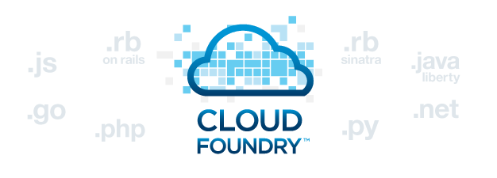







Developer Productivity, Choice, Control, & Consistency
Speed
Cloud Functions
“Serverless” / Event Driven Apps
Cloud Foundry
Language/ Framework
Open PaaS Environment
Portability
Container
Maximum Portability
Virtual Server or VMware
Leverage Existing Images & Tools
Performance & Control
Bare Metal
Maximum Performance & Control

Slide 4






Intelligent Scheduling
Self-healing
Horizontal scaling
Service discovery & load balancing
Automated rollouts and rollbacks
Secret and configuration management

Slide 5

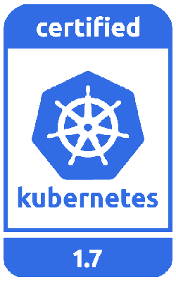
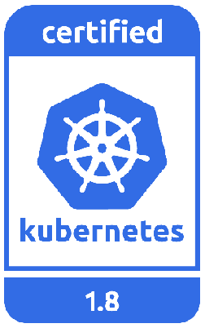
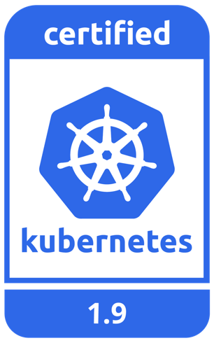
A managed Kubernetes service providing an intuitive user experience with on-going cluster management. Built-in security and isolation to enable rapid delivery of apps, while leveraging IBM Cloud Services including Weather data, IoT, Analytics, or AI capabilities with Watson. Available in six IBM regions WW, including 20+ datacenters.
https://www.ibm.com/cloud/container-service
Kubernetes Certified Service Provider
Kubernetes Technology Partner
Kubernetes Service Providers

Slide 6
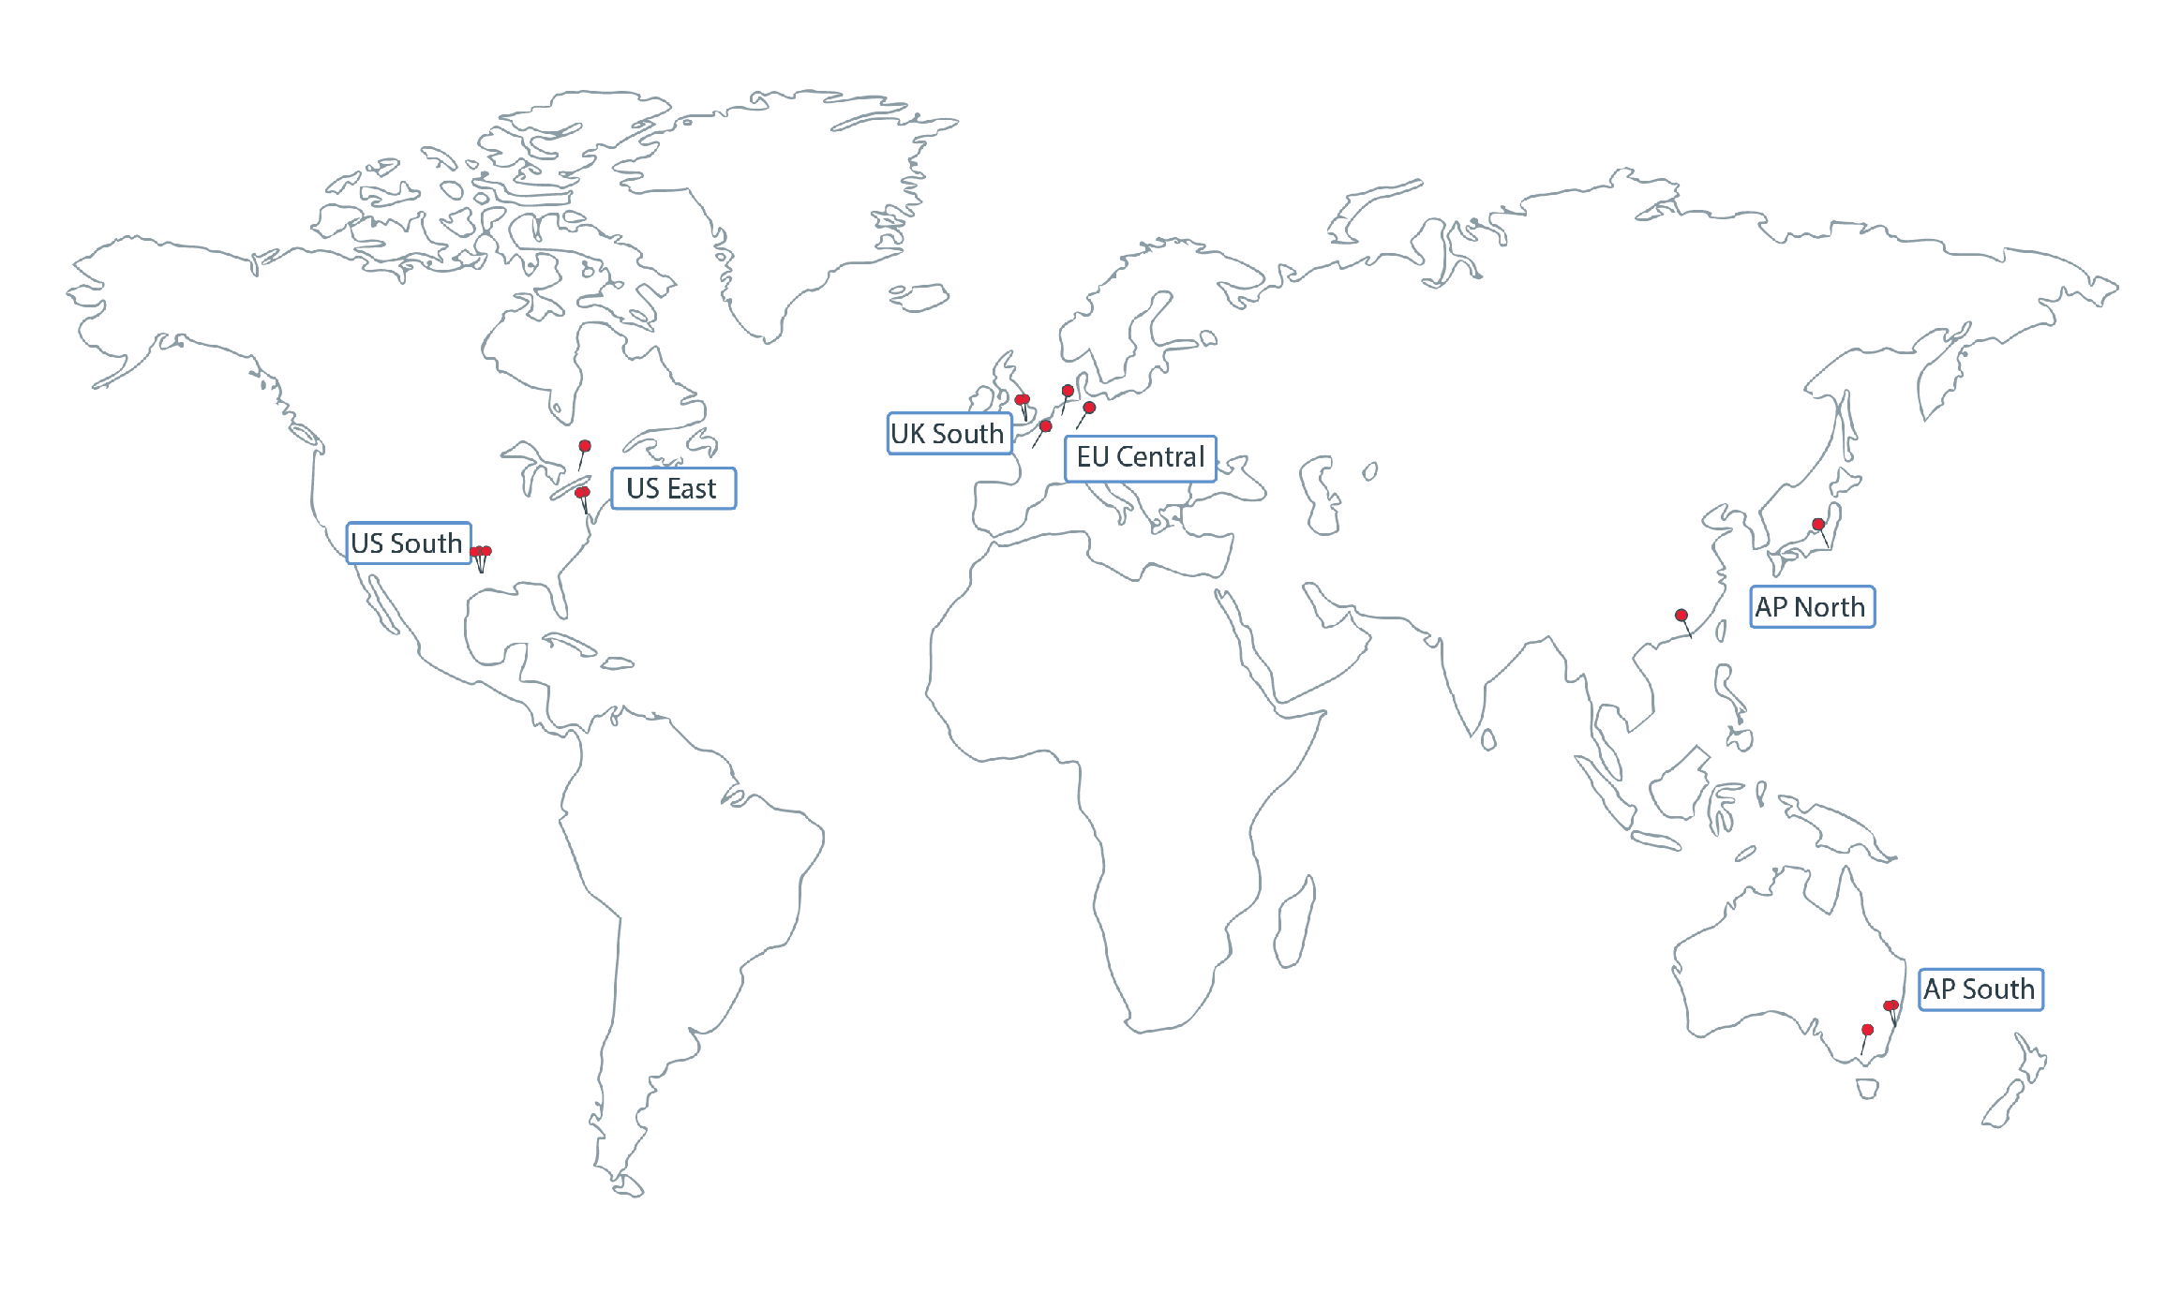
Datacenter Expansion - 6 IBM Cloud Regions, 20+ Datacenters
Region | Location | City
AP North | hkg02, tok02, sng01 | Hong Kong, Tokyo, Singapore
AP South | mel01, syd01, syd04 | Melbourne, Sydney
EU Central | ams03, fra02, par01, mil01 | Amsterdam, Frankfurt, Paris
UK South | lon02, lon04 | London
US East | tor01, wdc06, wdc07, mon01 | Toronto, Washington, DC, Montreal
US South | dal10, dal12, dal13, hou01, sao01 | Dallas, Sao Paulo
https://console.bluemix.net/docs/containers/cs_regions.html#regions-and-locations

Slide 7
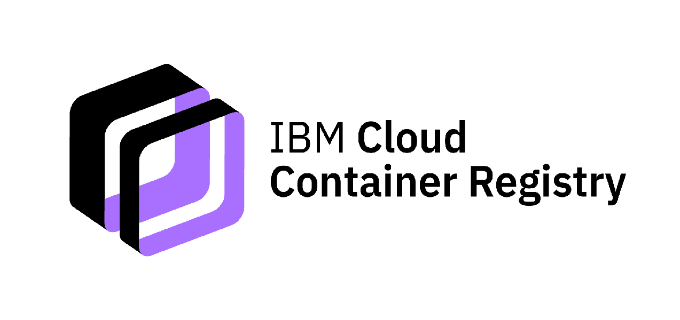
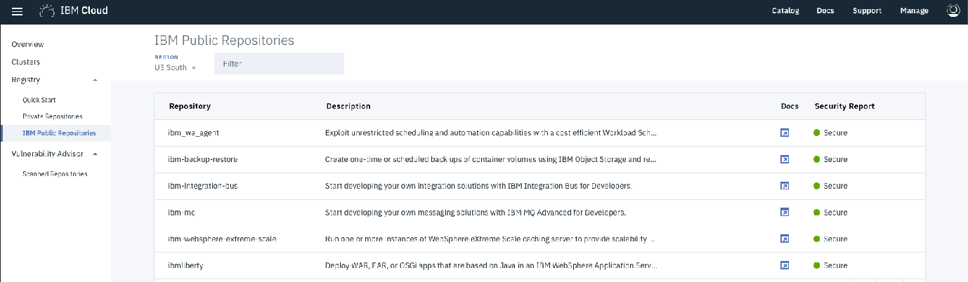
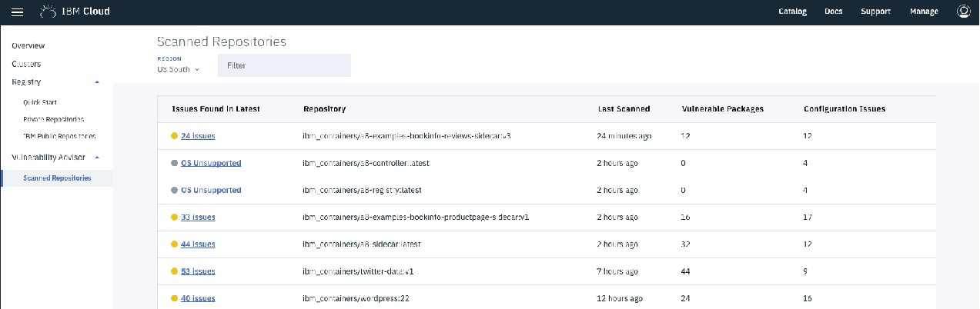
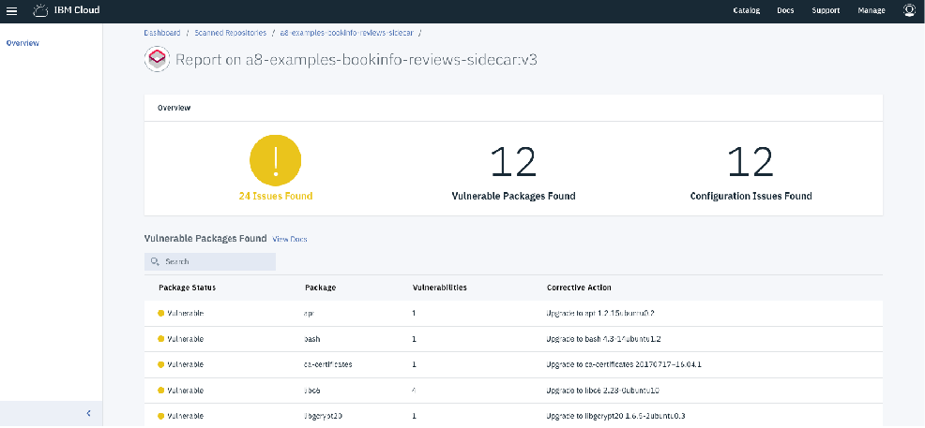
Product Definition
IBM managed stand-alone Docker image registry with integrated Vulnerability Advisor.
Value Proposition
IBM preferred image registry. Pre-integrated with our Kubernetes service. Secure with integration to IBM Identity and Access Manager. No need to configure and maintain storage for your images. Advanced capabilities such as vulnerability scanning, policy scanning, deployment policy enforcement, and integration to Docker Notary for image signing. The registry stores IBM curated content, open source, and customer provided images and Helm charts.
With our container service, users also have the option to deploy from an existing Docker registry (i.e., DockerHub, Quay, Artifactory, etc).
https://console.bluemix.net/docs/services/Registry/index.html
https://console.bluemix.net/docs/containers/va/va_index.html#va_index

Slide 8

Bring familiar tools to your Kubernetes clusters
Security
Orchestration
CI/CD Pipeline
Monitoring

Slide 9

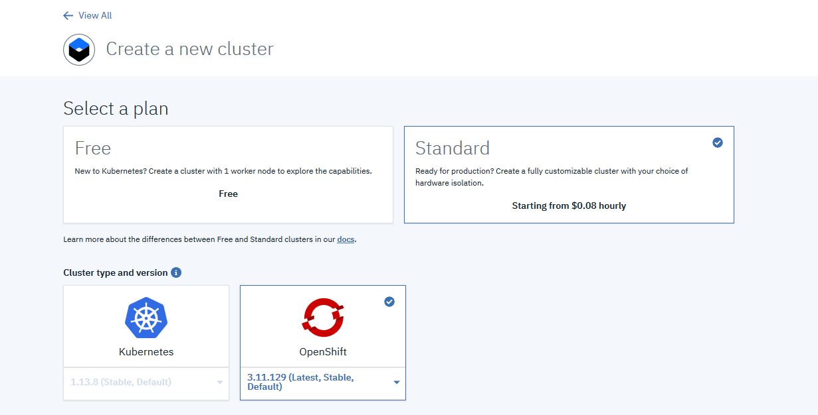
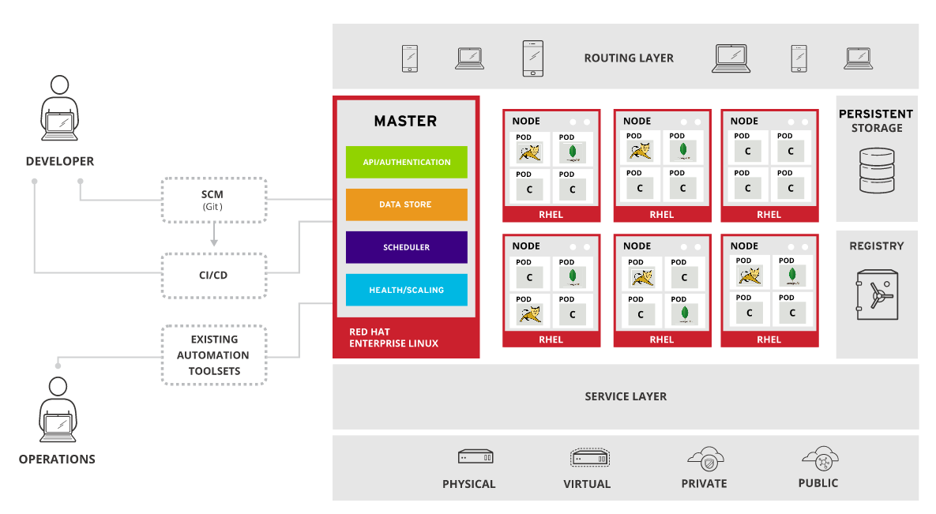

Slide 10
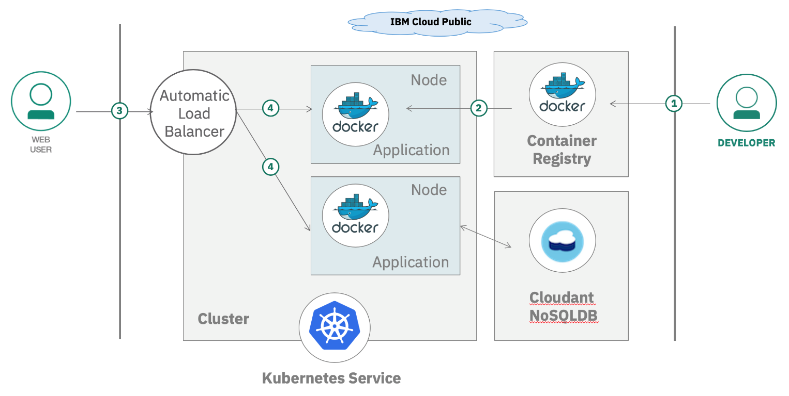
IKS 實作
Configure a custom Kubernetes cluster
IaasPaas Workshop - IKS.pdf

Slide 11
Jack Wu
scwu@tw.ibm.com

